Slide 1
Monitoring as a Service
PITERION – Accelerate your Progress.

Slide 2
Monitoring as a Service
Table of Content
Current situation
Related risks
Suggestions
Roadmap
Exporting this service to potential clients

Slide 3
Monitoring as a Service
Current Situation
The problem arises when looking at the current way Piterion handles its data about its running servers. We have no means other than connecting to the server to check its consumption statistics. This task is redundant and can take up a huge portion of a developer's time.
But, for the sake of the example, let's assume we have a developer monitoring only 1 server. After logging in, he'll be executing some commands to check resources consumptions. The data will be scattered all over the place, in its raw form. Without graphs and visuals, it's hard to detect anomalies and patterns.
Moreover, resource allocation for fresh servers is made with approximations that's not based on statistics/facts. This leads to Piterion overpaying/underpaying for its services' deployments.
However, Piterion is maintaining a good number of servers. Given that only 1 server can pose a challenge, is there a way to have a versatile and efficient mechanism to monitor them?

Slide 4
Monitoring as a Service
Risks
Not having a monitoring tool can pose many risks such as:
Not having the ability to detect anomalies.
Not being able to foresee/detect large inbound traffic.
Not giving oneself a grace period after anomaly detection to roll out patches/fixes before many users get affected.
No precise setting of performance benchmarks.
Human resources can be wasted on menial tasks that can be easily affected by human error.
Not being able to set cost expectations of scaled services.
Not having the ability to detect user behavior patterns and make strategic decisions accordingly.
Not having an overview of the databases states, health, disk management...

Slide 5

Grafana
A Graphical monitoring dashboard
We have produced an almost 0-cost solution to achieve this. We will be using a set of FOSS(Free Open Source Software).
Grafana is a multi-platform open source analytics and interactive visualization web application. It provides charts, graphs, and alerts for the web when connected to supported data sources.
This is where we aggregate all the data coming from different connected servers. See detailed graphs and take decisions based on factual statistics

Slide 6
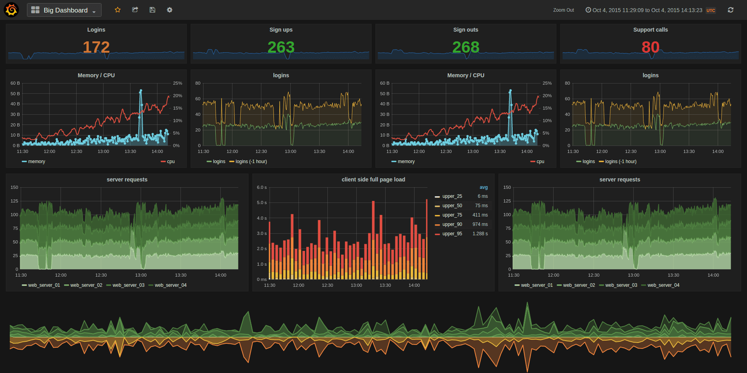
MONITORING as a service
GRAFANA: A Graphical monitoring dashboard

Slide 7
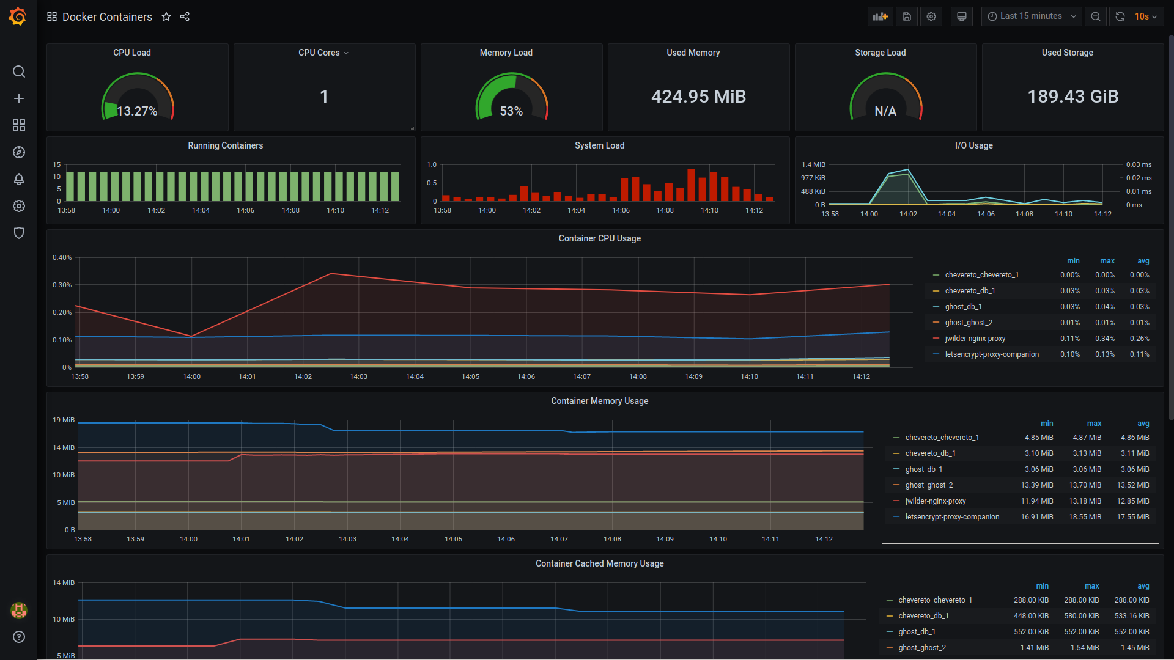
MONITORING as a service
GRAFANA: A Graphical monitoring dashboard

Slide 8

Monitoring as a service
Prometheus: A Time Series Database
This is where the data streamed from the different nodes will be stored.
It has its own Query language called PromQL. But we don't need to spend any time on this tool to get accustomed to it as Grafana automatically handles it under the hood when we add Prometheus as a Datasource from the Grafana dashboard.

Slide 9
Monitoring as a service
Data exporters
We have setup our graphical dashboard and our database so far. But how do we obtain the hardware and OS metrics from our servers?
This is where data exporters come into play. They are free and easy to install with Docker.
There is a plenty of data exporters for each specific need:
Exporting OS + Hardware metrics: Node-exporter
Exporting containers statistics: cAdvisor (from google)
Exporting Database statistics: There is an exporter for each DB technology
GPU Exporters: NVIDIA GPU Exporter
Full list of exporters:
https://prometheus.io/docs/instrumenting/exporters/

Slide 10
Monitoring as a service
Roadmap
Install the set of software on a central monitoring server. Done
Install exporters on target servers that are to be integrated into the monitoring process. Done Partially
Automate the installation of the central toolset with Ansible. Done
Automate the installation of the different exporters with Ansible. Done
Security enhancement. This will be explained in the next slide. Pending

Slide 11
Monitoring as a service
Roadmap: Security enhancements
It's considered a best-practice to run every software on a Zero-Trust Network. This means that one should take no implicit assumptions about the network's safety just because it's a private network. Data in transit is as important as data in rest.
To solve this, exporters should not be exposed publicly with a port (Here we consider the Private Network "public").
But sit behind a proxy and delegate securing the communication channels with SSL/TLS to the proxy.
So, we need to automate the configuration of new proxies or already running ones when integrating a new server to the chain.
This is a challenging problem and difficult to automate because there is no pre-defined standard procedure of employing proxies, every server runs its own flavor of proxy (Apache/Nginx/traefik...). So we'll deal with this point later down the road.

Slide 12
Monitoring as a service
MaaS
One could argue that every growing business will run into a subset of the risks we presented earlier. So there are many opportunities to sell this toolset as a product.
A counterpoint could be that every bit of software we used is FOSS. So what exactly are we offering that's not available on the market?
Piterion will be offering an already wired together service with a CLI that will render the installation of a central monitoring service and integrating remote servers to this process a seamless task. The CLI will rely on powerful automations tools like Ansible, Docker...

Slide 13
PITERION GmbH
Niederlassung Ismaning
Reichenbachstraße 2
85737 Ismaning
eMail: oussema.zouaghi@piterion.com
Web: www.piterion.com

